Slide 1


Java ee
(ADVANCE JAVA)
Lecture-50

Slide 2
Today’s Agenda
Introduction To JQuery
Advantages Of JQuery
Downloading JQuery
Examples

Slide 3
WHAT IS JQUERY?
jQuery is a precoded JavaScript library.
In other words , it is a collection of predefined JavaScript functions which makes it easier for us to use JavaScript on our website.

Slide 4
ADVANTAGES OF JQUERY
The biggest advantage of jQuery comes from its selectors that allow us to traverse the DOM tree of an HTML document's structure in an efficient manner.
Additionally, using the jQuery inbuilt methods we can create animations and effects like sliding transition, showing or hiding an element, etc. with a single line of code.

Slide 5
ADVANTAGES OF JQUERY
Saves lots of time — We can save lot of time and efforts by using the jQuery inbuilt effects and selectors
Simplifies common JavaScript tasks — jQuery considerably simplifies the common JavaScript tasks. Now we can easily create feature rich and interactive web pages with fewer lines of codes, a typical example is retrieving the information from a server and updates the page without refreshing.

Slide 6
ADVANTAGES OF JQUERY
Easy to use — jQuery is very easy to use. Anybody with the basic working knowledge of HTML, CSS and JavaScript can start development with jQuery.
Compatible with browsers — jQuery is created with modern browsers in mind and it is compatible with all major modern browsers such as Mozilla Firefox, Google Chrome, Safari, Internet Explorer, and Opera.
Absolutely Free — And the best part is, it is completely free to download and use.

Slide 7
HOW TO INSTALL JQUERY
There are two ways to install jQuery :
Call direct from a CDN
a) Faster Download.
b) Might have already been cached.
Download your own copy
a) Works with no internet connection.

Slide 8
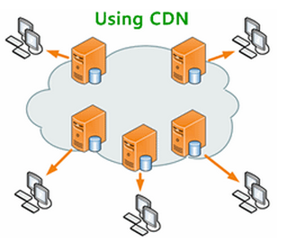
WHAT IS A CDN?
CDN stands for Content Delivery Network and is a system of distributed servers (network) that deliver webpages and other web content to a user.

Slide 9
GETTING JQUERY FROM CDN
To get jQuery from a CDN just mention the URL of the CDN in <script> tag.
From Google CDN
<script src=“http://ajax/googleapis.com/ajax/libs/jquery/3.1.1/jquery.min.js’></script>
From Microsoft CDN
<script src=http://ajax.aspnetcdn.com/ajax/jQuery/jquery-3.1.0.min.js></script>

Slide 10
EXAMPLE
<html>
<head>
<title>Getting Jquery From Google</title>
<script
src=“https://ajax.googleapis.com/ajax/libs/jquery/3.1.1/jquery.min.js">
</script>
<script>
// your code goes here
</script>
</head>
<body>
..
</body>
</html>

Slide 11
DOWNLOADING JQUERY
We can download it from www.jquery.com
There are two versions :
“Production” for our live website , because it has been minified and compressed to take up the least amount of space.
“Development” for testing and development. It hasn’t been minified or compressed, so we can read the code in-case we want to know how jquery works.

Slide 12
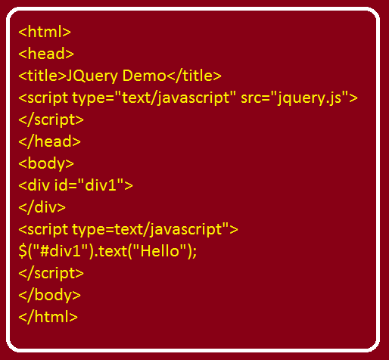
FIRST EXAMPLE

Slide 13
THE READY EVENT
In jQuery there is a special event called ready belonging to document object which allows us to assign some code and the browser will execute this code as soon as the loading the page is over.
So in this way we can remove jquery code from body tag and put it in head tag

Slide 14
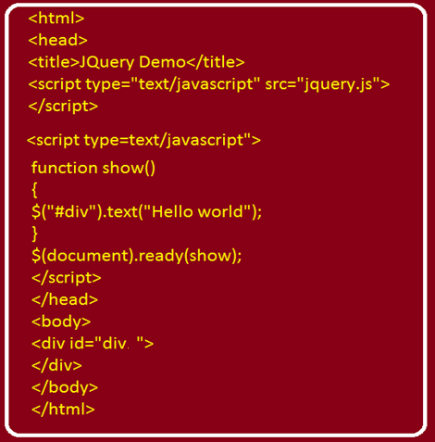
EXAMPLE

Slide 15
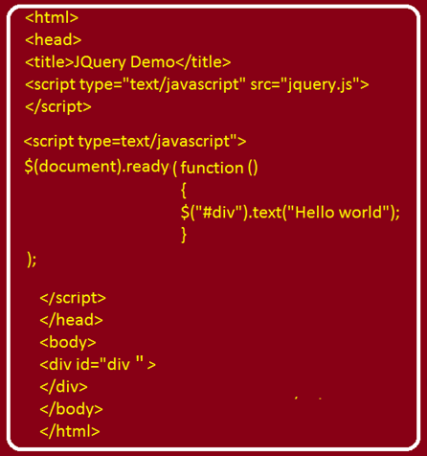
ANONYMOUS FUNCTION WITH READY EVENT

Slide 16
CHANGING FONT
In jQuery we have a function called css( ) which is used to change CSS properties of HTML elements.
For ex: to change font color - >
$(“#div1”).text(“Hello World”);
$(“#div1”).css(“color”,”red”);

Slide 17
CHAINING METHODS
jQuery allows us to chain methods i.e. we can call second method in continuation with the first method and this proves to be very handy way of writin ghte code.
For ex: to set the font and change it’s color
$(“#div1”).text(“Hello World”).css(“color”,”red”);

Slide 18
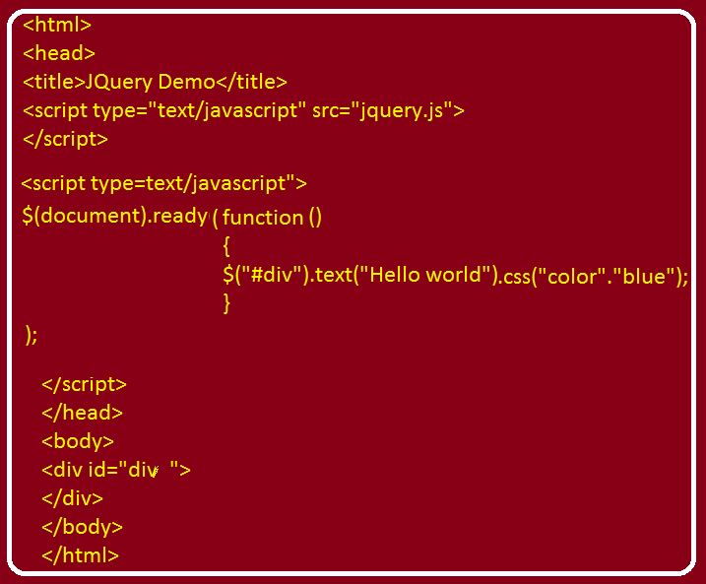
EXAMPLE

Slide 19
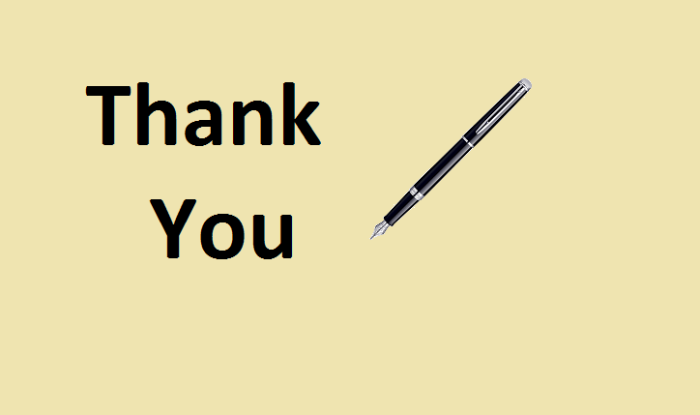
End Of Lecture
For any queries mail us @: scalive4u@gmail.com
Call us @ : 0755-4271659, 7879165533
Agenda for Next Lecture:
Introduction To Jquery Selectors
Types Of Selectors
Selector Syntax And Uses
Examples

